Slide 1
ACCOMPLICE EVIDENCE
© Sumiti Ahuja, Assistant Professor, Law Centre-II, Faculty of Law,
University of Delhi

Slide 2
DEFINITION OF ACCOMPLICE
The word has not been defined under the Indian Evidence Act, 1872.
In ordinary sense, accomplice is a guilty associate or partner in crime (particeps criminis), or who sustains such a relation to the criminal act that he could be jointly indicted with the principal.
Primary meaning of accomplice is any party to the crime charged and some one who aids and abets the commission of crime [Sheshanna Bhumanna Yadav v. State of Maharashtra, AIR 1970 SC 1330].
Accomplice is a person who knowingly or voluntarily co-operates with or aids and assists another in the commission of a crime (presence of mens rea is of importance for someone to be called as accomplice/approver).

Slide 3
Hon’ble Supreme Court of India in R.K. Dalmia v. Delhi Administration AIR 1962 SC 1821, observed that: “An accomplice is a person who- participates in the commission of the actual crime charged against an accused. He is to be particeps criminis. There are two cases however, in which a person has been held to be an accomplice even if he is not particeps criminis; Receivers of stolen property are taken to be accomplices of the thieves, from whom they receive goods, on a trial of theft. Accomplices in previous similar offences committed by the accused on trial deemed to be accomplices in the offence for which the accused is on trial, when evidence of the accused having committed crimes of identical type on other occasions be admissible to prove the system and intent of the accused in committing the offence charged.”

Slide 4
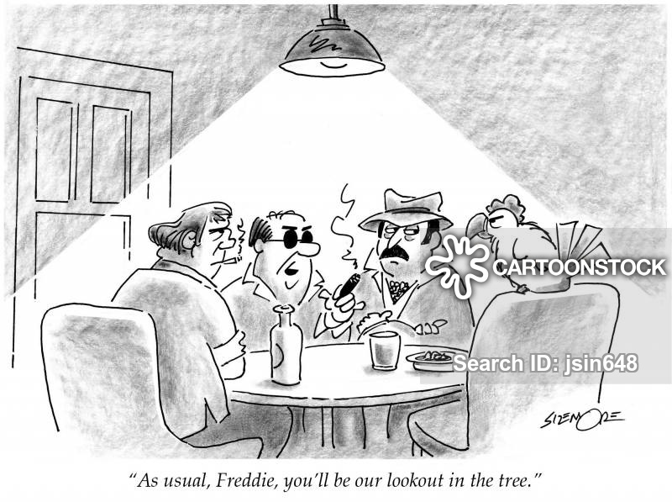
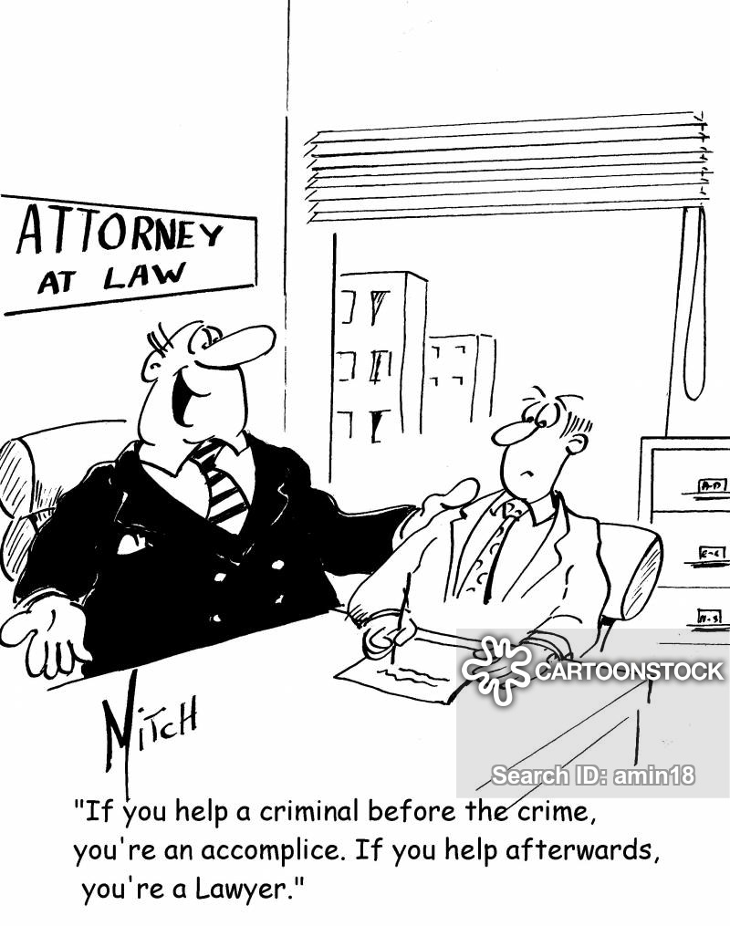

Slide 5
CATEGORIES OF ACCOMPLICE
CATEGORIES OF ACCOMPLICE
Principal Offender of First Degree
Principal Offender of Second Degree
Accessory before the fact
Accessory after the fact
Principal Offender of first degree is a person who actually commits the crime.
Principal Offender of second degree is a person who either abets or aids the commission of crime.
Accessory before the fact is a person who abets, incites, procures or counsels for the commission of crime but does not himself participate in the commission of that crime.
Accessory after the fact is a person who receives or comforts or protects persons who have committed the crime knowing that they have committed it. If he helps the accused in escaping from punishment or helps him from not being arrested, such a person is guilty of harbouring the accused.

Slide 6
WHO IS AN ACCOMPLICE WITNESS?
Accomplice witness is someone who is both a witness to a crime and an accomplice in that same crime. Witness to a crime who either as principal, or accessory, was connected with the crime by unlawful act or omission on his or her part, either before, at the time or after commission of the offence.
If the witness cannot be prosecuted for the offense with which the accused is charged, then the witness is not an accomplice witness as a matter of law. Moreover, a witness is not an accomplice witness merely because he or she knew of the offense and did not disclose it, or even concealed it.

Slide 7
Accomplices are usually interested and always infamous witness and whose testimony is admitted from necessity, it being often impossible without having recourse to such evidence, to bring the principal offenders to justice.
Accomplice testimony in a criminal trial is highly relevant and often essential in the prosecution of crime, particularly organized crime, collar crime, and political corruption. Given the accomplice’s obvious motive to tailor his or her testimony to satisfy the prosecutor, however, such testimony is also quite often of questionable reliability.

Slide 8
WHEN IS AN ACCOMPLICE COMPETENT WITNESS?
If an accomplice is jointly indicted with his fellows, he is incompetent to testify, unless he is tendered a pardon; or unless he has been discharged, acquitted or convicted.
In other words, accomplice is a competent witness, if, at the time he is required to give evidence, he is not an accused person in the case in which he is required to testify.
An accomplice by accepting a pardon under section 306 of CrPC, 1973, becomes a competent witness and may as any other witness be examined on oath, and the prosecution must be withdrawn and the accused formally discharged under section 321, CrPC, 1973.

Slide 9
Under Art. 20(3) of the Constitution of India, 1950, no accused shall be compelled to be a witness against himself. But an accomplice accepts a pardon of his free will on condition of a true disclosure, in his own interest and is not compelled to give self-incriminating evidence.
Under section 308(1) of CrPC, 1973, when a pardoned accused who is bound to make full disclosure, fails to do so, either by willfully concealing anything essential or by giving false evidence, not complied with the condition on which the tender was made, such person may be tried for the offence in respect of which the pardon was so tendered or for any other offence of which he appears to have been guilty in connection with the same matter.

Slide 10
Importance of Sections 114 and 133, IEA, and Necessity of Corroboration
Section 133 of the IEA, 1872, describes about competency of accomplice. It provides: “An accomplice shall be a competent witness against an accused person; and a conviction is not illegal merely because it proceeds upon the uncorroborated testimony of an accomplice”.
Illustration (b) to section 114, IEA, states that an accomplice is unworthy of credit, unless he is corroborated in material particulars.
Reading above two provisions, it is clear that the most important issue with respect to accomplice evidence is that of corroboration.

Slide 11
Insistence upon corroboration is based on the rule of caution and is not a rule of law.
Joint reading of both sections points out that: ‘a conviction based on the uncorroborated testimony of an accomplice is not illegal, but according to prudence it is not safe to rely upon uncorroborated evidence of accomplice and thus judges must exercise extreme caution and care while considering uncorroborated accomplice evidence’.

Slide 12
Accomplice evidence is untrustworthy and therefore should be corroborated for the following reasons:
  An accomplice is likely to swear falsely in order to shift the guilt from himself;
  An accomplice is a participator in crime and thus an immoral person;
  An accomplice gives his evidence under a promise of pardon or in the expectation of pardon, if he discloses all he knows against those with whom he acted criminally, and this hope would lead him to favour the prosecution. Thus, by means of a pardon, he transfers himself from the accused’s dock to the witness-box as an approver, to give evidence for the state.

Slide 13
Appreciation of accomplice’s or approver’s evidence therefore, has to satisfy a double test. His evidence must show that he is a reliable witness and that is a test which is common to all witnesses. If this test is satisfied the second test which still remains to be applied is that the approver’s evidence must receive sufficient corroboration. This test is special to the cases of weak or tainted evidence like that of the approver [Sarwan Singh Rattan Singh v. State of Punjab, AIR 1957 SC 637].

